Slide 1
CHAPTER 5/6
Constraints and Anomalies

Slide 2
Constraints
Column constraints – in-line constraints:
NOT NULL,
UNIQUE,
PRIMARY KEY,
FOREIGN KEY,
REF,
CHECK, and
DEFAULT

Slide 3
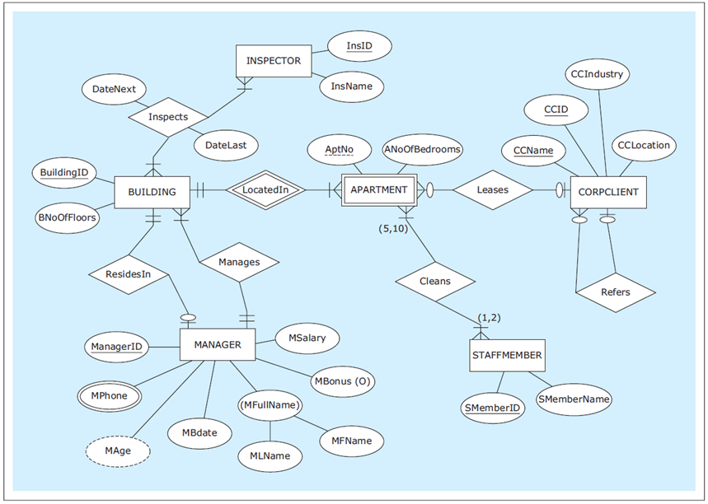
ER diagram: HAFH Realty Company Property Management Database
Notes:
This example is discussed on Pages 157-163.

Slide 4
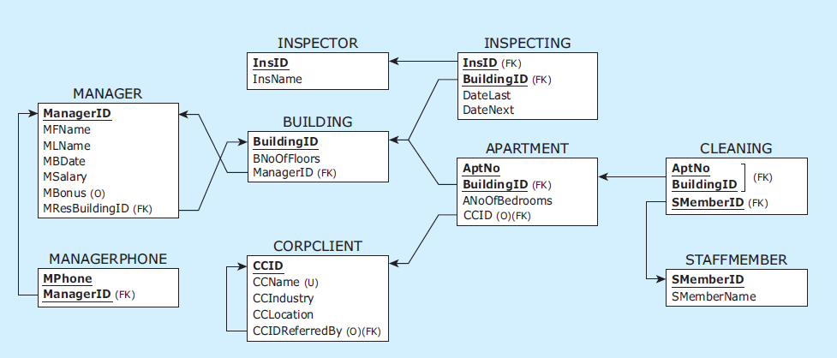
Relational schema: HAFH Realty Company Property Management Database
Notes:
This example is discussed on Pages 157-163.

Slide 5
CREATE TABLE statements for HAFH Realty Company Property Management Database
CREATE TABLE manager
( managerid CHAR(4) NOT NULL,
mfname VARCHAR(15) NOT NULL,
mlname VARCHAR(15) NOT NULL,
mbdate DATE NOT NULL,
msalary NUMERIC(9,2) NOT NULL,
mbonus NUMERIC(9,2),
mresbuildingid CHAR(3),
PRIMARY KEY (managerid) );
CREATE TABLE managerphone
( managerid CHAR(4) NOT NULL,
mphone CHAR(11) NOT NULL,
PRIMARY KEY (managerid, mphone),
FOREIGN KEY (managerid) REFERENCES manager(managerid) );
CREATE TABLE building
( buildingid CHAR(3) NOT NULL,
bnooffloors INT NOT NULL,
bmanagerid CHAR(4) NOT NULL,
PRIMARY KEY (buildingid),
FOREIGN KEY (bmanagerid) REFERENCES manager(managerid) );
Notes:
This example is discussed on Pages 157-163.

Slide 6
CREATE TABLE statements for HAFH Realty Company Property Management Database
CREATE TABLE inspector
( insid CHAR(3) NOT NULL,
insname VARCHAR(15) NOT NULL,
PRIMARY KEY (insid) );
CREATE TABLE inspecting
( insid CHAR(3) NOT NULL,
buildingid CHAR(3) NOT NULL,
datelast DATE NOT NULL,
datenext DATE NOT NULL,
PRIMARY KEY (insid, buildingid),
FOREIGN KEY (insid) REFERENCES inspector(insid),
FOREIGN KEY (buildingid) REFERENCES building(buildingid) );
CREATE TABLE corpclient
( ccid CHAR(4) NOT NULL,
ccname VARCHAR(25) NOT NULL,
ccindustry VARCHAR(25) NOT NULL,
cclocation VARCHAR(25) NOT NULL,
ccidreferredby CHAR(4),
PRIMARY KEY (ccid),
UNIQUE (ccname),
FOREIGN KEY (ccidreferredby) REFERENCES corpclient(ccid) );
Notes:
This example is discussed on Pages 157-163.

Slide 7
CREATE TABLE statements for HAFH Realty Company Property Management Database
CREATE TABLE apartment
( buildingid CHAR(3) NOT NULL,
aptno CHAR(5) NOT NULL,
anoofbedrooms INT NOT NULL,
ccid CHAR(4),
PRIMARY KEY (buildingid, aptno),
FOREIGN KEY (buildingid) REFERENCES building(buildingid),
FOREIGN KEY (ccid) REFERENCES corpclient(ccid) );
CREATE TABLE staffmember
( smemberid CHAR(4) NOT NULL,
smembername VARCHAR(15) NOT NULL,
PRIMARY KEY (smemberid) );
CREATE TABLE cleaning
( buildingid CHAR(3) NOT NULL,
aptno CHAR(5) NOT NULL,
smemberid CHAR(4) NOT NULL,
CONSTRAINT cleaningpk PRIMARY KEY (buildingid, aptno, smemberid),
CONSTRAINT cleaningfk1 FOREIGN KEY (buildingid, aptno)
REFERENCES apartment(buildingid, aptno),
CONSTRAINT cleaningfk2 FOREIGN KEY (smemberid)
REFERENCES staffmember(smemberid) );
Notes:
This example is discussed on Pages 157-163.

Slide 8
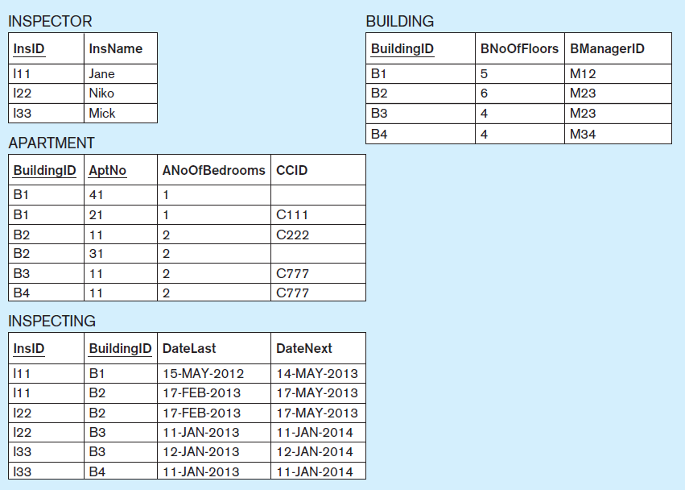
Data records: HAFH Realty Company Property Management Database (part 1)
Notes:
This example is discussed on Pages 157-163.

Slide 9
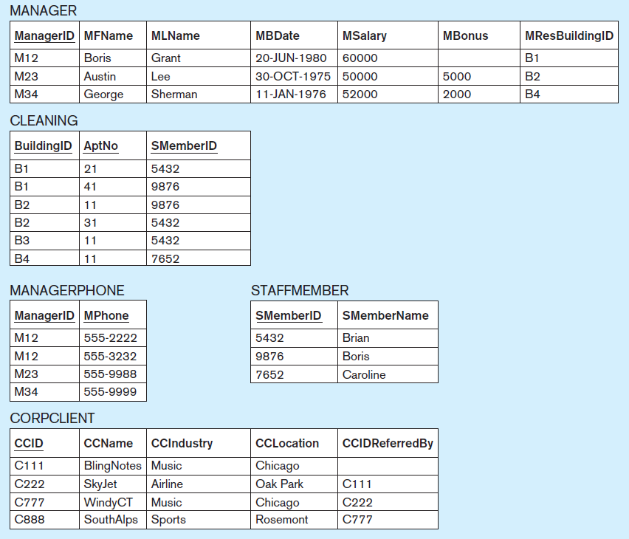
Data records: HAFH Realty Company Property Management Database (part 2)
Notes:
This example is discussed on Pages 157-163.

Slide 10
INSERT INTO statements for HAFH Realty Company Property Management Database
INSERT INTO manager VALUES ('M12', 'Boris', 'Grant', '20/Jun/1980', 60000, null, null);
INSERT INTO manager VALUES ('M23', 'Austin', 'Lee', '30/Oct/1975', 50000, 5000, null);
INSERT INTO manager VALUES ('M34', 'George', 'Sherman', '11/Jan/1976', 52000, 2000, null);
INSERT INTO managerphone VALUES ('M12','555-2222');
INSERT INTO managerphone VALUES ('M12','555-3232');
INSERT INTO managerphone VALUES ('M23','555-9988');
INSERT INTO managerphone VALUES ('M34','555-9999');
INSERT INTO building VALUES ('B1', '5', 'M12');
INSERT INTO building VALUES ('B2', '6', 'M23');
INSERT INTO building VALUES ('B3', '4', 'M23');
INSERT INTO building VALUES ('B4', '4', 'M34');
INSERT INTO inspector VALUES ('I11', 'Jane');
INSERT INTO inspector VALUES ('I22', 'Niko');
INSERT INTO inspector VALUES ('I33', 'Mick');
INSERT INTO inspecting VALUES ('I11','B1','15/May/2012','14/May/2013');
INSERT INTO inspecting VALUES ('I11','B2','17/Feb/2013','17/May/2013');
INSERT INTO inspecting VALUES ('I22','B2','17/Feb/2013','17/May/2013');
INSERT INTO inspecting VALUES ('I22','B3','11/Jan/2013','11/Jan/2014');
INSERT INTO inspecting VALUES ('I33','B3','12/Jan/2013','12/Jan/2014');
INSERT INTO inspecting VALUES ('I33','B4','11/Jan/2013','11/Jan/2014');
INSERT INTO corpclient VALUES ('C111', 'BlingNotes', 'Music', 'Chicago', null);
INSERT INTO corpclient VALUES ('C222', 'SkyJet', 'Airline', 'Oak Park', 'C111');
INSERT INTO corpclient VALUES ('C777', 'WindyCT', 'Music', 'Chicago', 'C222');
INSERT INTO corpclient VALUES ('C888', 'SouthAlps', 'Sports', 'Rosemont', 'C777');
Notes:
This example is discussed on Pages 157-163.

Slide 11
INSERT INTO statements for HAFH Realty Company Property Management Database
INSERT INTO apartment VALUES ('B1', '21', 1, 'C111');
INSERT INTO apartment VALUES ('B1', '41', 1, null);
INSERT INTO apartment VALUES ('B2', '11', 2, 'C222');
INSERT INTO apartment VALUES ('B2', '31', 2, null);
INSERT INTO apartment VALUES ('B3', '11', 2, 'C777');
INSERT INTO apartment VALUES ('B4', '11', 2, 'C777');
INSERT INTO staffmember VALUES ('5432', 'Brian');
INSERT INTO staffmember VALUES ('9876', 'Boris');
INSERT INTO staffmember VALUES ('7652', 'Caroline');
INSERT INTO cleaning VALUES ('B1', '21', '5432');
INSERT INTO cleaning VALUES ('B1', '41', '9876');
INSERT INTO cleaning VALUES ('B2', '11', '9876');
INSERT INTO cleaning VALUES ('B2', '31', '5432');
INSERT INTO cleaning VALUES ('B3', '11', '5432');
INSERT INTO cleaning VALUES ('B4', '11', '7652');
Notes:
This example is discussed on Pages 157-163.

Slide 12
Referential Integrity Constraints

Slide 13
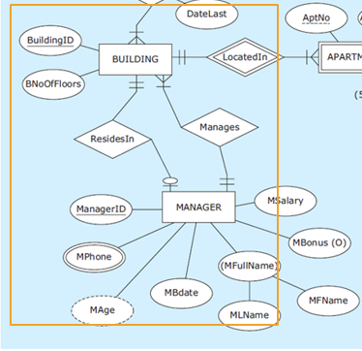
CONSTRAINT MANAGEMENT
CREATE TABLE manager
( managerid CHAR(4) NOT NULL,
mfname VARCHAR(15) NOT NULL,
mlname VARCHAR(15) NOT NULL,
mbdate DATE NOT NULL,
msalary NUMERIC(9,2) NOT NULL,
mbonus NUMERIC(9,2),
mresbuildingid CHAR(3),
PRIMARY KEY (managerid)
);
CREATE TABLE building
( buildingid CHAR(3) NOT NULL,
bnooffloors INT NOT NULL,
bmanagerid CHAR(4) NOT NULL,
PRIMARY KEY (buildingid),
FOREIGN KEY (bmanagerid) REFERENCES manager(managerid)
);
Column mresbuildingid
Is not declared as a foreign key YET.
MresBuildingID in Manager implements relationship ResidentsIn
BmanagerID in Building implements the relationship Manages

Slide 14
CONSTRAINT MANAGEMENT
Referential integrity constraints
Alter Statement 5: ALTER TABLE manager ADD CONSTRAINT FKResidesIn FOREIGN KEY (mresbuildingid) REFERENCES building (buildingid);
Then add values
Update Statement 4: UPDATE manager SET mresbuildingid = 'B1' WHERE managerid = 'M12'; Update Statement 5: UPDATE manager SET mresbuildingid = 'B2' WHERE managerid = 'M23'; Update Statement 6: UPDATE manager SET mresbuildingid = 'B4' WHERE managerid = 'M34';
And add the Referential integrity constraints
Alter Statement 6: ALTER TABLE manager MODIFY (mresbuildingid NOT NULL);
Notes:
This example is discussed on Pages 157-163.

Slide 15
CONSTRAINT MANAGEMENT
Referential Integrity Constraint prevents deletion of a primary key that has existing foreign key referring to it
So drop the tables that has foreign keys before we could drop the tables at which the foreign key refers.

Slide 16
CONSTRAINT MANAGEMENT
DROP TABLE sequence HAFH database—First seven tables: DROP TABLE cleaning; DROP TABLE staffmember; DROP TABLE apartment; DROP TABLE corpclient; DROP TABLE inspecting; DROP TABLE inspector; DROP TABLE managerphone;
Alter Statement 7: ALTER TABLE manager DROP CONSTRAINT fkresidesin;
DROP TABLE sequence HAFH database—Last two tables: DROP TABLE building; DROP TABLE manager;
Notes:
This example is discussed on Pages 157-163.

Slide 17
REFERENTIAL INTEGRITY CONSTRAINT
Referential integrity constraint - In each row of a relation containing a foreign key, the value of the foreign key EITHER matches one of the values in the primary key column of the referred relation OR the value of the foreign key is null (empty).
Regulates the relationship between a table with a foreign key and a table with a primary key to which the foreign key refers

Slide 18
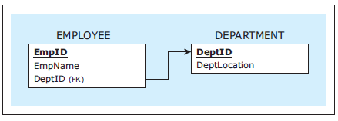
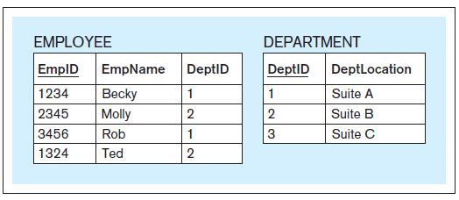
REFERENTIAL INTEGRITY CONSTRAINT
Referential integrity constraint compliance example
Two relations and a referential integrity constraint
Data records in compliance with the referential integrity constraint

Slide 19
REFERENTIAL INTEGRITY CONSTRAINT: DELETE AND UPDATE IMPLEMENTATION OPTIONS
Referential integrity constraint - delete and update implementation options
Delete options
DELETE RESTRICT
DELETE CASCADE
DELETE SET-TO-NULL
DELETE SET-TO-DEFAULT
Update options
UPDATE RESTRICT
UPDATE CASCADE
UPDATE SET-TO-NULL
UPDATE SET-TO-DEFAULT

Slide 20
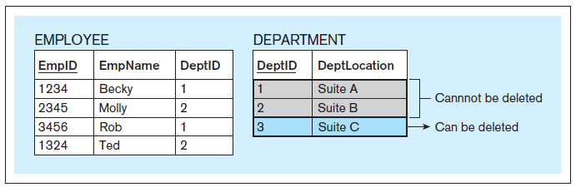
REFERENTIAL INTEGRITY CONSTRAINT: DELETE AND UPDATE IMPLEMENTATION OPTIONS
DELETE RESTRICT example
Delete restrict option does not allow a record to be deleted if its PK value is referred to by a FK value.
Notes:
This example is discussed on Pages 178-179.

Slide 21
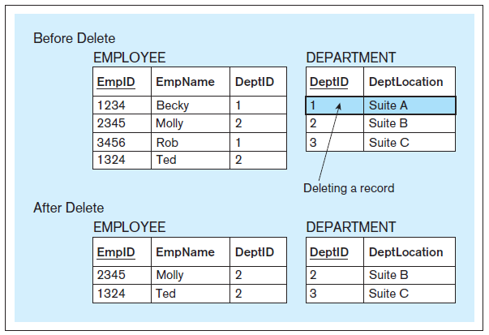
REFERENTIAL INTEGRITY CONSTRAINT: DELETE AND UPDATE IMPLEMENTATION OPTIONS
DELETE CASCADE example
The delete cascade option allows a record to be deleted if its PK value is referred to by a FK value
Notes:
This example is discussed on Page 181.

Slide 22
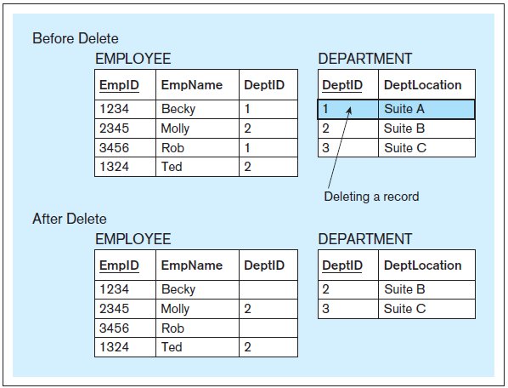
REFERENTIAL INTEGRITY CONSTRAINT: DELETE AND UPDATE IMPLEMENTATION OPTIONS
DELETE SET-TO-NULL example
Notes:
This example is discussed on Page 180.

Slide 23

REFERENTIAL INTEGRITY CONSTRAINT: DELETE AND UPDATE IMPLEMENTATION OPTIONS
DELETE SET-TO-DEFAULT example
Notes:
This example is discussed on Pages 180-181.

Slide 24
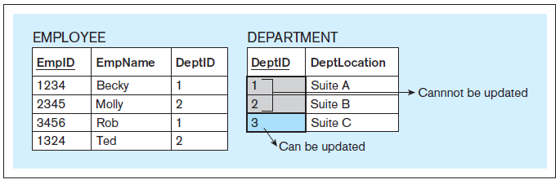
REFERENTIAL INTEGRITY CONSTRAINT: DELETE AND UPDATE IMPLEMENTATION OPTIONS
UPDATE RESTRICT example
Notes:
This example is discussed on Pages 178-179.

Slide 25
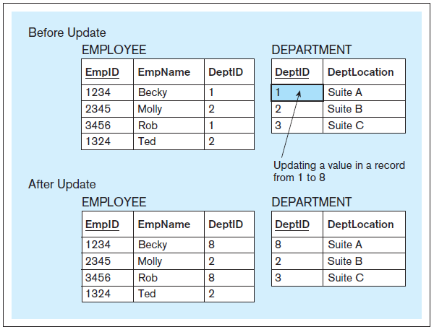
REFERENTIAL INTEGRITY CONSTRAINT: DELETE AND UPDATE IMPLEMENTATION OPTIONS
UPDATE CASCADE example
Notes:
This example is discussed on Page 181.

Slide 26
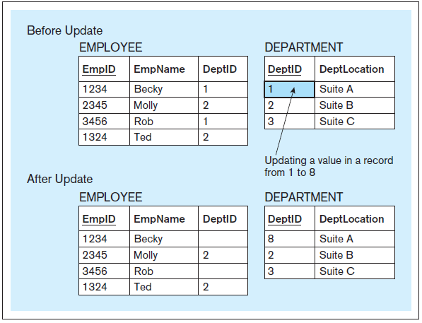
REFERENTIAL INTEGRITY CONSTRAINT: DELETE AND UPDATE IMPLEMENTATION OPTIONS
UPDATE SET-TO-NULL example
Notes:
This example is discussed on Pages 182-183.

Slide 27
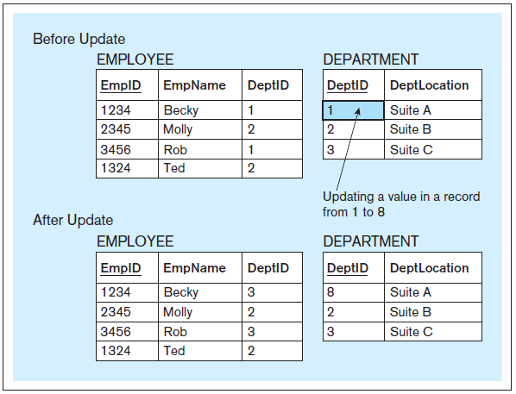
REFERENTIAL INTEGRITY CONSTRAINT: DELETE AND UPDATE IMPLEMENTATION OPTIONS
UPDATE SET-TO-DEFAULT example
Notes:
This example is discussed on Pages 183-184.

Slide 28
REFERENTIAL INTEGRITY CONSTRAINT: DELETE AND UPDATE IMPLEMENTATION OPTIONS
Implementing delete and update options
Example - DELETE RESTRICT and UPDATE RESTRICT CREATE TABLE employee ( empid CHAR(4), empname CHAR(20), deptid CHAR(2), PRIMARY KEY (empid), FOREIGN KEY (deptid) REFERENCES department
);
Notes:
This example is discussed on Page 184.

Slide 29
REFERENTIAL INTEGRITY CONSTRAINT: DELETE AND UPDATE IMPLEMENTATION OPTIONS
Implementing delete and update options
Example - DELETE CASCADE CREATE TABLE employee ( empid CHAR(4), empname CHAR(20), deptid CHAR(2), PRIMARY KEY (empid), FOREIGN KEY (deptid) REFERENCES department ON DELETE CASCADE
);
Notes:
This example is discussed on Page 184.

Slide 30
REFERENTIAL INTEGRITY CONSTRAINT: DELETE AND UPDATE IMPLEMENTATION OPTIONS
Implementing delete and update options
Example – UPDATE SET-TO-NULL CREATE TABLE employee ( empid CHAR(4), empname CHAR(20), deptid CHAR(2), PRIMARY KEY (empid), FOREIGN KEY (deptid) REFERENCES department ON UPDATE SET NULL
);
Notes:
This example is discussed on Page 184.

Slide 31
REFERENTIAL INTEGRITY CONSTRAINT: DELETE AND UPDATE IMPLEMENTATION OPTIONS
Implementing delete and update options
Example - DELETE CASCADE and UPDATE SET-TO-NULL CREATE TABLE employee ( empid CHAR(4), empname CHAR(20), deptid CHAR(2), PRIMARY KEY (empid), FOREIGN KEY (deptid) REFERENCES department ON DELETE CASCADE ON UPDATE SET NULL);
Notes:
This example is discussed on Page 185.

Slide 32
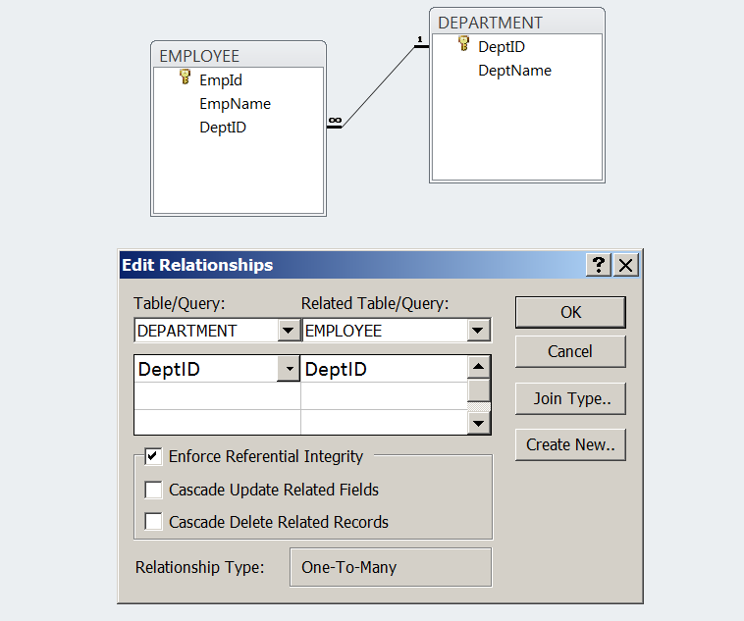
REFERENTIAL INTEGRITY CONSTRAINT: DELETE AND UPDATE IMPLEMENTATION OPTIONS
Implementing delete and update options
Example - DELETE RESTRICT and UPDATE RESTRICT (MS Access)
Notes:
This example is discussed on Page 185.

Slide 33
IMPLEMENTING USER-DEFINED CONSTRAINTS
Implementing user-defined constraints
Methods for implementing user-defined constraints include:
CHECK clause
Assertions and triggers
Coding in specialized database programming languages that combine SQL with additional non-SQL statements for processing data from databases (such as PL/SQL)
Embedding SQL with code written in regular programming languages (such as C++ or Java)
In many cases the logic of user-defined constraints is not implemented as a part of the database, but as a part of the front-end database application

Slide 34
IMPLEMENTING USER-DEFINED CONSTRAINTS
CHECK
Used to specify a constraint on a particular column of a relation

Slide 35
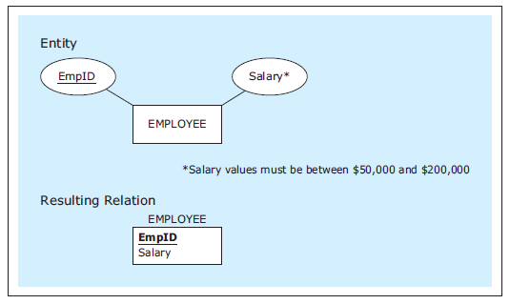
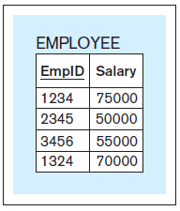
CHECK – Example 1
A relation with a user-defined constraint
CREATE TABLE employee
(empid CHAR(4),
salary NUMBER(6) CHECK (salary >= 50000 AND salary <= 200000),
PRIMARY KEY (empid));
INSERT INTO employee VALUES ('1234', 75000);
INSERT INTO employee VALUES ('2345', 50000);
INSERT INTO employee VALUES ('3456', 55000);
INSERT INTO employee VALUES ('1324', 70000);
INSERT INTO employee VALUES ('9876', 270000);
INSERT INTO employee VALUES ('1010', 30000);
SQL code
Four inserts accepted, two inserts rejected
Notes:
This example is discussed on Pages 185-186

Slide 36
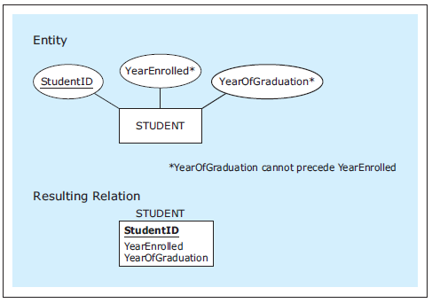
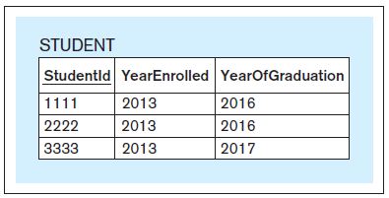
CHECK – Example 2
A relation with a user-defined constraint
CREATE TABLE student
(studentid CHAR(4),
yearenrolled INT,
yearofgraduation INT,
PRIMARY KEY (studentid), CHECK (yearenrolled <= yearofgraduation));
INSERT INTO student VALUES ('1111', 2012, 2016);
INSERT INTO student VALUES ('2222', 2013, 2017);
INSERT INTO student VALUES ('3333', 2013, 2017);
INSERT INTO student VALUES ('4444', 2013, 2012);
SQL code
Three inserts accepted, one insert rejected
Notes:
This example is discussed on Pages 185-186

Slide 37
IMPLEMENTING USER-DEFINED CONSTRAINTS
Implementing user-defined constraints
In many cases the logic of user-defined constraints is not implemented as a part of the database, but as a part of the front-end database application
For the proper use of the database, it is important that user-defined constraints are implemented fully
Notes:
From the business use point of view, the enforcement of user-defined constraints is more important than which actual method of implementing the user-defined constraint was chosen. Often, when there is more than one method available, the choice is made based on technical considerations, such as which of the methods provides for the fastest execution.

Slide 38
ASSERTIONS
Assertion
A mechanism for specifying user-defined constraints

Slide 39
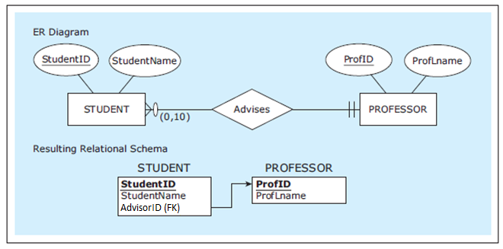
ASSERTIONS
Assertion
Example:
CREATE ASSERTION profsadvisingupto10students CHECK ( (SELECT MAX(totaladvised) FROM ( SELECT count(*) AS totaladvised FROM student GROUP BY advisorid)) < 11);
Notes:
This example is discussed on Page 202.

Slide 40
TRIGGERS
A rule (written using SQL) that is activated by a deletion of a record, insertion of a record, or modification (update) of a record in a relation
More flexible than constraints
Can be fired before or after insert, update, delete
Trigger can access values it needs as :OLD. and :NEW.
prefix :OLD refers to values in a tuple deleted or to the values replaced in an update
prefix :NEW refers to the values in a tuple just inserted or to the new values in an update.
Can specify whether trigger fires just once for each triggering statement, or for each row that is changed by the statement
Use ECA model:
Event, some change made to the database
Condition, a logical predicate
Action, procedure done when the event occurs and the condition is true, also called firing the trigger
Notes:
Even though CREATE ASSERTION is part of the SQL standard, most RDBMS packages do not implement assertions using CREATE ASSERTION. Most RDBMS packages are capable of implementing the functionality of the assertion through different, more complex types of mechanisms, such as triggers.

Slide 41
Trigger – Example
CREATE TRIGGER studentinserttrigger BEFORE INSERT ON student FOR EACH ROW BEGIN
DECLARE totaladvised INT DEFAULT 0; SELECT COUNT(*) INTO totaladvised FROM student WHERE advisorid = NEW.advisorid; IF (totaladvised >= 10) THEN
SET NEW.advisorid = NULL; END IF; END;
CREATE TRIGGER studentupdatetrigger BEFORE UPDATE ON student FOR EACH ROW BEGIN DECLARE totaladvised INT DEFAULT 0; SELECT COUNT(*) INTO totaladvised FROM student WHERE advisorid = NEW.advisorid; IF (totaladvised >= 10) THEN SET NEW.Advisorid = NULL; END IF; END;
Notes:
This example is discussed on Page 203.

Slide 42
Trigger – Example
INSERT INTO student VALUES ('1111', 'Mark', 'P11');
EXECUTED AS:
INSERT INTO student VALUES ('1111', 'Mark', 'P11');
OR
INSERT INTO student VALUES ('1111', 'Mark', null);
Notes:
This example is discussed on Page 203.

Slide 43
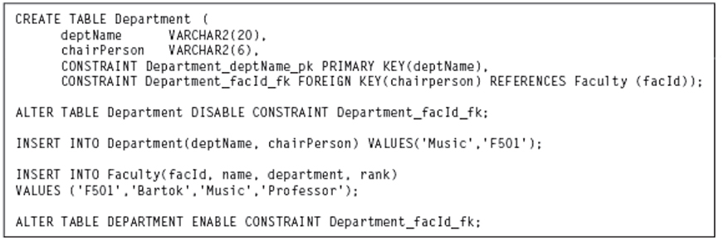
Trigger Syntax
CREATE OR REPLACE TRIGGER trigger_name
[BEFORE/AFTER] [INSERT/UPDATE/DELETE] ON table_name
[FOR EACH ROW] [WHEN condition]
BEGIN
trigger body
END;
Can disable triggers using ALTER TRIGGER name DISABLE;
Later write ALTER TRIGGER name ENABLE;
Can drop triggers using DROP TRIGGER name;
See examples
Figure 5.5 Enabling and Disabling Constraints

Slide 44
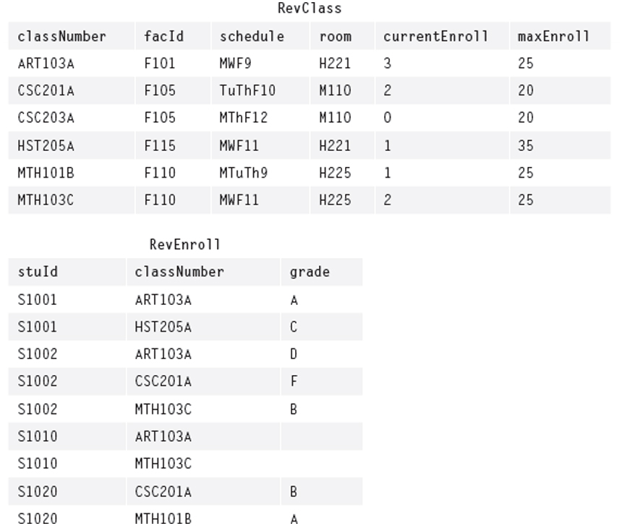
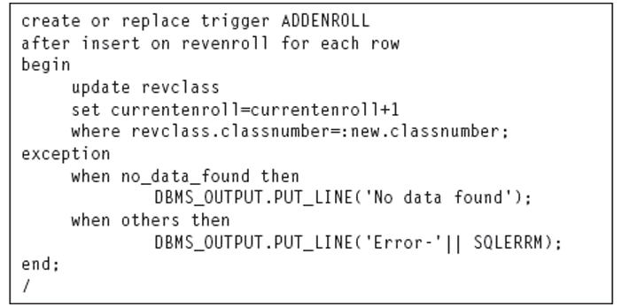
Figure 5.6A Tables for Triggers
Figure 5.6B Trigger for Student Enrolling in a Class

Slide 45
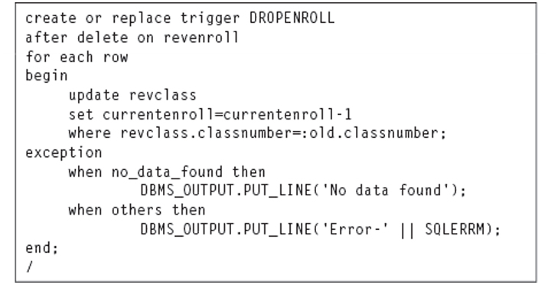
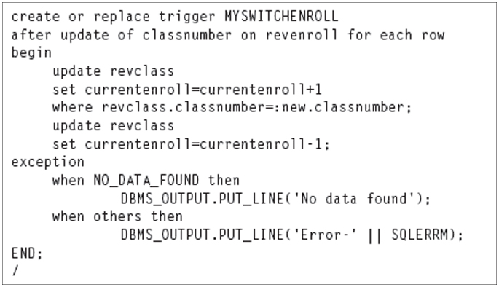
Figure 5.6C Trigger for Student Dropping Classes
Figure 5.6D Trigger for Student Changing Classes

Slide 46
Backup additional stuff

Slide 47
Additional DB – Not included in final Exam
Database front-end
Provides access to the database for indirect use
Notes:
In most cases, a portion of intended users (often a majority of the users) of the database lack the time and/or expertise to engage in the direct use of the data in the database. It is not reasonable to expect every person who needs to use the data from the database to write his or her own queries and other statements.

Slide 48
DATABASE FRONT-END
Form
Enables data input and retrieval for end users
Provides an interface into a database relation or query

Slide 49
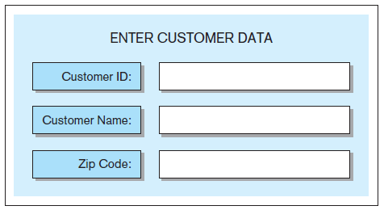
Form – Example 1
SQL code generated:
INSERT INTO customer VALUES (…)
Notes:
This example is discussed on Pages 192-193

Slide 50
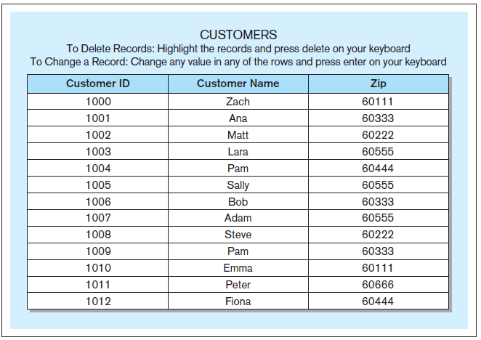
Form – Example 2
Sample SQL code generated:
DELETE FROM customer WHERE custid = '1012';
UPDATE customer
SET custname = 'Zachary'
WHERE custid = '1000';
Notes:
This example is discussed on Page 193

Slide 51
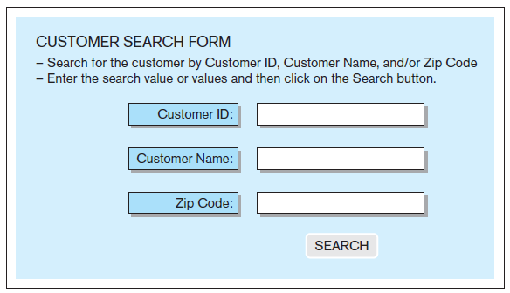
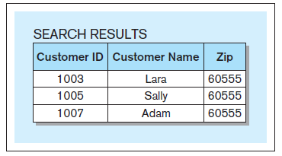
Form – Example 3
Sample SQL code generated:
SELECT * FROM customer WHERE zip = '60555';
Notes:
This example is discussed on Pages 193-194

Slide 52
DATABASE FRONT-END
Report
Presents the data and calculations on the data from one or more tables from the database in a formatted way
The data that is retrieved via reports is formatted and arranged to be displayed on the screen or printed as a hard copy

Slide 53
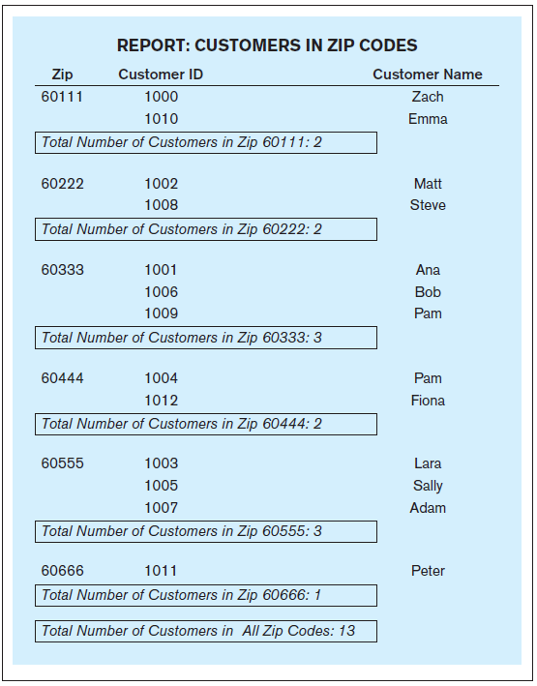
Report – Example
Notes:
This example is discussed on Pages 194-195

Slide 54
DATABASE FRONT-END
In addition to the forms and reports, database front-end applications can include many other components and functionalities, such as:
menus
charts
graphs
maps
etc.
The choice of how many different components to use and to what extent is driven by the needs of the end-users
A database can have multiple sets of front-end applications for different purposes or groups of end-users
Notes:
Front-end applications can be accessible separately on their own or via an interface that allows the user to choose an application that they need.

Slide 55
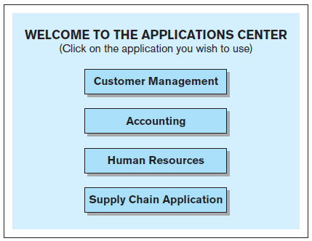
Front-end interface – Example An example of an interface to a collection of database front-end applications
Notes:
This example is discussed on Pages 195-196

Slide 56
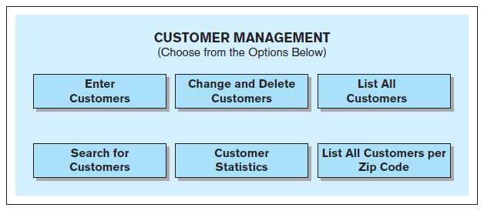
Front-end interface – Example An example of an interface to a database front-end application
Notes:
This example is discussed on Pages 195-196

Slide 57
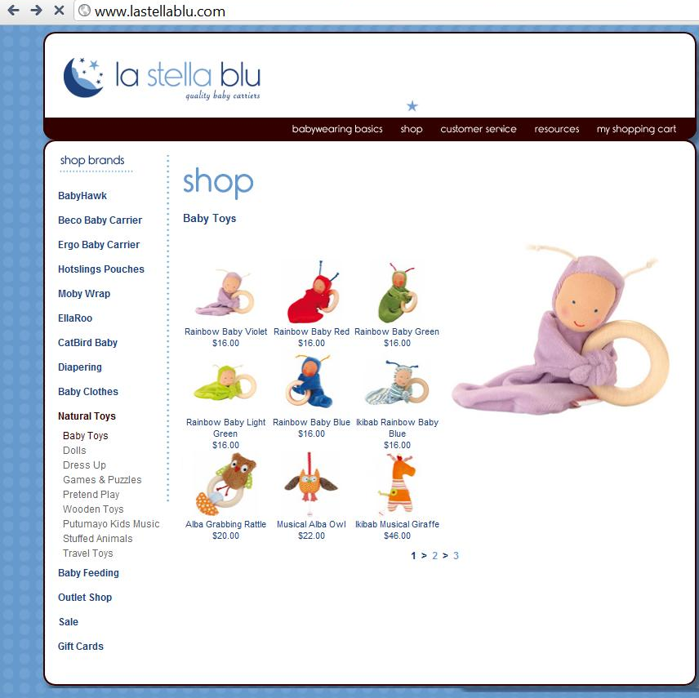
Web page - Example
Notes:
This example is discussed on Pages 196-197

Slide 58
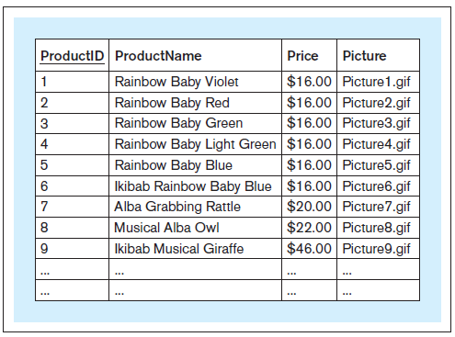
Web page - Example A database relation storing the content of the Web site
Notes:
This example is discussed on Pages 196-197

Slide 59
DATA QUALITY
Data quality
The data in a database is considered of high quality if it correctly and non-ambiguously reflects the real-world it is designed to represent
Data quality characteristics
Accuracy
Uniqueness
Completeness
Consistency
Timeliness
Conformity

Slide 60
DATA QUALITY
Accuracy - the extent to which data correctly reflects the real-world instances it is supposed to depict
Notes:
Example given on Page 197.

Slide 61
DATA QUALITY
Uniqueness - requires each real-world instance to be represented only once in the data collection
The uniqueness data quality problem is sometimes also referred to as data duplication
Notes:
Example given on Page 198.

Slide 62
DATA QUALITY
Completeness - the degree to which all the required data is present in the data collection
Notes:
Example given on Page 198.

Slide 63
DATA QUALITY
Consistency - the extent to which the data properly conforms to and matches up with the other data
Notes:
Examples given on Page 198.

Slide 64
DATA QUALITY
Timeliness - the degree to which the data is aligned with the proper time window in its representation of the real world
Typically, timeliness refers to the “freshness” of the data
Notes:
Example given on Page 198.

Slide 65
DATA QUALITY
Conformity - the extent to which the data conforms to its specified format
Notes:
Example given on Pages 198-199.

Slide 66
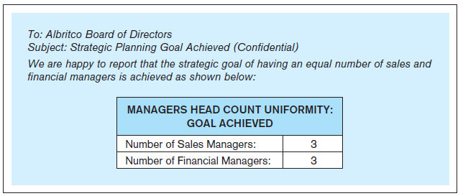
Data quality – Example A message reporting the head count of the managers in the Albritco company
Notes:
This example is discussed on Pages 199-202.

Slide 67
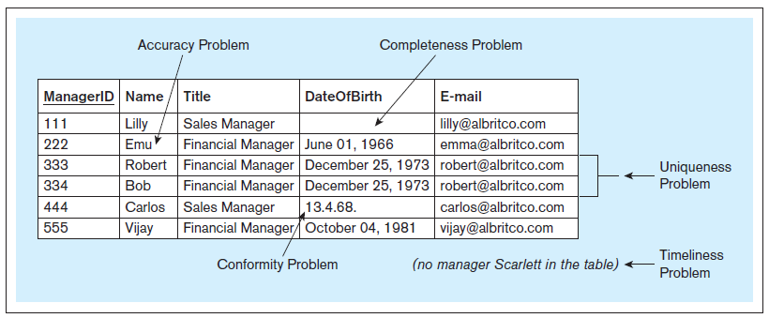
Data quality – Example Albritco database relation with data quality issues
Notes:
This example is discussed on Pages 199-202.

Slide 68
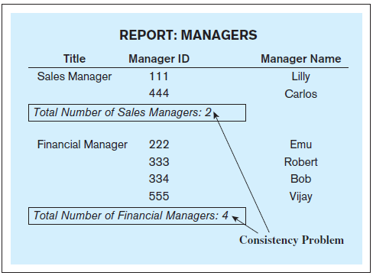
Data quality – Example A report based on the Albritco relation with data quality issues
Notes:
This example is discussed on Pages 199-202.

Slide 69
DATA QUALITY
Preventive data quality actions
Actions taken to preclude data quality problems
Corrective data quality actions
Actions taken to correct the data quality problems
Notes:
Examples of preventive and corrective data quality actions are given on Pages 200-201.

Slide 70
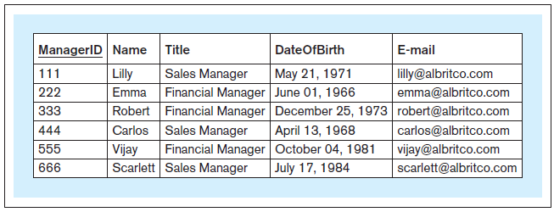
Data quality – Example Albritco database relation with the data quality issues resolved
Notes:
This example is discussed on Pages 199-202.

Slide 71
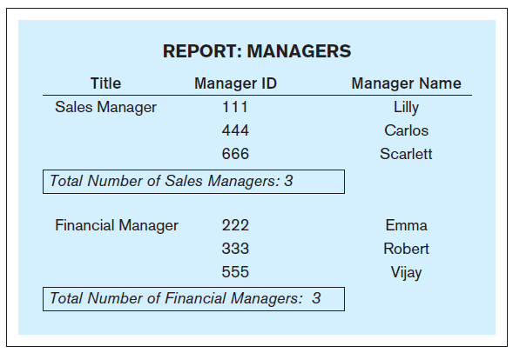
Data quality – Example A report based on the Albritco relation with the data quality issues resolved
Notes:
This example is discussed on Pages 199-202.

